Slide 1
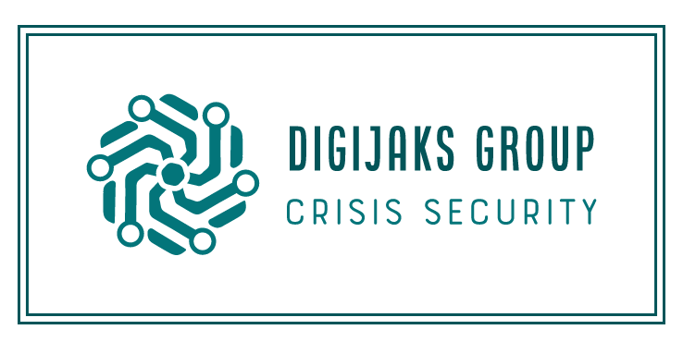
Digijaks Group Global Covid19 Response
October 2020 www.digijaks.com

Slide 2
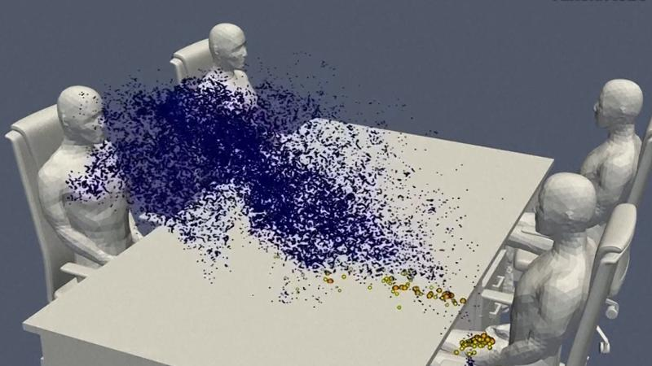
Covid19 Emergency Response Overview
Digijaks Group, LLC is a certified Covid19 Emergency Response Vendor.
FEMA. The United Nations. State of California. State of New York. State of Michigan. State of Virginia.
Digijaks is a certified supplier to HealthTrust, one of the 8 largest GPOs in the US.
Digijaks has powerful previous history as buyer of record, with supply chain security, and final delivery of PPE.

Slide 3
Problems solved.
Certified US NIOSH + US FDA/CDC certified N95 respirator face masks in large bulk orders from the factories. Shipments to anywhere in US. MOQ-2000-10,000,000 USA + INDIA
US FDA/CDC Certified Level 1, 2,3, 4 Isolation Gowns. Bulk size orders direct from Factories. MOQ 10,000-1,000,000 Made In USA and Vietnam, China and India.
1
3
2
Bulk scheduled orders of production run Nitrile Gloves from Vietnam, Thailand, Malaysia. Sea/Air cargo conveyor belt model. FOB/CIF/DAP 510K FDA certified.
4
US FDA certified Ventilators -
Multiple vendors direct from Factory

Slide 4
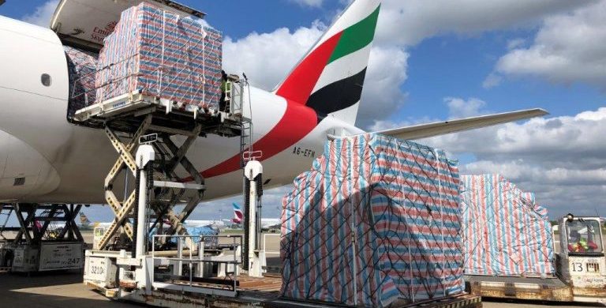
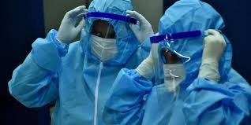
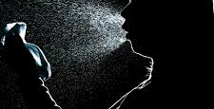
Process
Proof of Funds
LOI/PO
Production Contract / FCO
01
Bank letter, Escrow, Letter of Credit, or Wire Transfer -- Funds to be released post SGS inspection depending on agreed upon terms.
03
02
Binding letter of intent or purchase order
Will enter in production contract and FCO into shipment. At time of shipment SGS inspection utilized to confirm

Slide 5

Thank you.
Digijaks Group, LLC 1-307-683-0460 www.digijaks.com digijakshq@digijaks.com

